Slide 1


Data Management
Tutor: Ms Low Jia Xin Contact: 65500529
Email: low_jia_xin@nyp.edu.sg

Slide 2
Week 5 Topics
Official (Open)
Relational Database
Rows and Columns
Primary key
SQL
Creating, Using, Deleting database
Creating and Dropping tables
Data types
Retrieving Data using SELECT statement
Arithmetic Operator
Alias
Insertion and Deletion of Records

Slide 3

Relational Database Management Systems (Recap)
Official (Open)
Relational Database Management System (RDBMS)
Relational databases organize data into tables with rows and columns.
Records in different tables can be connected through the use of primary and foreign keys. Relational databases are built around the SQL programming language
Notes:
Joining tables using a key

Slide 4
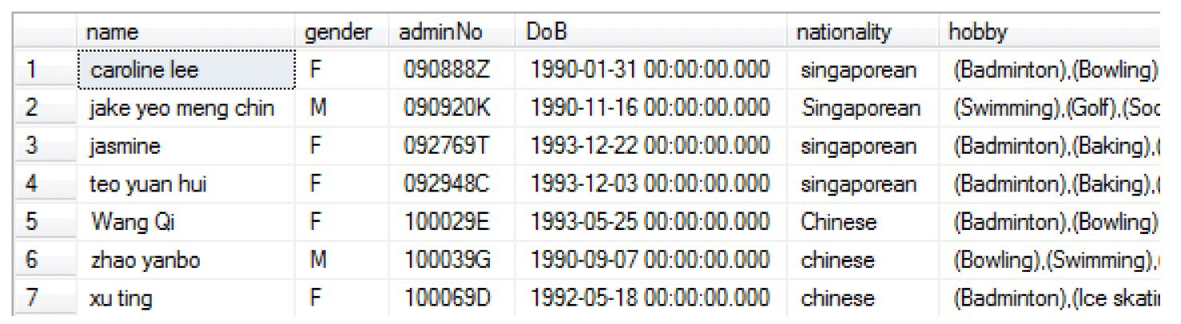
Rows and columns
Official (Open)
Tables is relational database contains rows and columns.
For example, rows can refer to students, columns refer to attributes.

Slide 5
Primary key
Official (Open)
A primary key is a special relational database table column (or combination of columns) designated to uniquely identify all table records.
A primary key's main features are: It must contain a unique value for each row of data. It cannot contain null values.
Student
student_id | name | major
1 | Jack | Biology
2 | Kate | Sociology
3 | Claire | English
4 | Jack | Biology
5 | Mike | Comp. Sci
Notes:
Unique identifier.
Name is not a unique identifier because everyone can have a same name
Admin number is one example of a primary key ( cannot have the exact same as people )

Slide 6
Structured Query Language (SQL)
Official (Open)
A language used for interacting with Relational Database Management Systems (RDBMS)
You can use SQL to get RDBMS to do following tasks:
CRUD operations (Create, Retrieve, Update, Delete) on data
Create and manage databases
Design and create database tables
Perform administration tasks (security, user management, import/export etc)
Notes:
A structured programming language to talk to the computer

Slide 7
Creating database
Official (Open)
Syntax:
CREATE DATABASE <database_name>
<database_name> is limited to 128 characters long.
Example:
CREATE DATABASE StudentDB CREATE DATABASE EmployeeDB
The keywords in SQL Server are NOT case-sensitive
(meaning ‘A’ is equivalent to ‘a’).
Notes:
Database name don’t put long ( use a meaningful name )
DB mean database so you know is which database
Recommended to use all caps
Database is a container that contains many tables
Tables are where you fill all your data in

Slide 8
Using a database
Official (Open)
Syntax:
USE <database_name>
You would do this, if you have several databases.
Notes:
To select database of different database

Slide 9
Deleting a database
Official (Open)
To delete an existing database in SQL Server, Syntax:
DROP DATABASE <database_name> E.g.
DROP DATABASE StudentDB
DROP DATABASE EmployeeDB
Be CAREFUL when doing DROP databases.
Be sure to double check what you are doing is correct!
Notes:
Cannot recovered once dropped everyth

Slide 10
Creating a table
Official (Open)
To create a new table in an existing database in SQL Server. Syntax:
CREATE TABLE <tablename> (
<column1name> <column1type>,
<column2name> <column2type>,
…………..
<columnNname> <columnNtype>
)
Notes:
Need to specify datatype and column name

Slide 11
Creating a table - example
Official (Open)
CREATE TABLE PersonInfo (
PersonID int,
LastName nvarchar(25) NOT NULL, FirstName nvarchar(25) NOT NULL, Address nvarchar(255) NOT NULL, City nvarchar(30) NOT NULL, Savings float,
PRIMARY KEY (PersonID)
)
unique
Notes:
Example of how you create a table
NOT NULL -> must have smth inside if not there will be error
If you specify as a primary key, it will automatically not be null

Slide 12
Primary key
Official (Open)
A primary key is a special relational database table column to uniquely identify all table records.
It cannot have NULL values for any row. NULL means no value.
A primary key in most tables is a single column (field), but it can be composite (consist of more than 1 column) in some cases.
student_id | name | major
1 | Jack | Biology
2 | Kate | Sociology
3 | Claire | English
4 | Jack | Biology
5 | Mike | Comp. Sci
Notes:
Identify a person using primary key

Slide 13
Data types
Official (Open)
Some common column data types:
varchar(X) - Can store string of characters up to a length of X characters.
INT – Whole Numbers (no need to specify how many digits)
DECIMAL (M,N) – Decimal. M: total number of digits. N: number of digits after decimal point
DATE – ‘YYYY-MM-DD’
DATETIME / TIMESTAMP - ‘YYYY-MM-DD HH:MM:SS’
Notes:
String -> “abc” or “abc123”
Eg. Varchar(40) -> you specify 40 characters for your string
Eg. 123.456 -> DECIMAL(6,3)

Slide 14
Dropping table
Official (Open)
To delete (or drop) a table
Syntax:
DROP TABLE <tablename>

Slide 15
Insertion of records/rows
Official (Open)
To insert rows into the table Syntax:
INSERT INTO <tablename>
VALUES (<value1>, <value2> , <value3> , …., <valueN> )
Strings must be enclosed in single quotes. All fields are separated by commas.
Notes:
According to sequence of column
Put NULL if there is no value

Slide 16
Deletion of records
Official (Open)
To delete all records from a table syntax:
DELETE FROM <tablename>
To delete some records from a table, syntax:
DELETE FROM <tablename> WHERE <condition>
What is the difference between DELETE FROM <tablename>
and DROP TABLE <tablename> ?

Slide 17
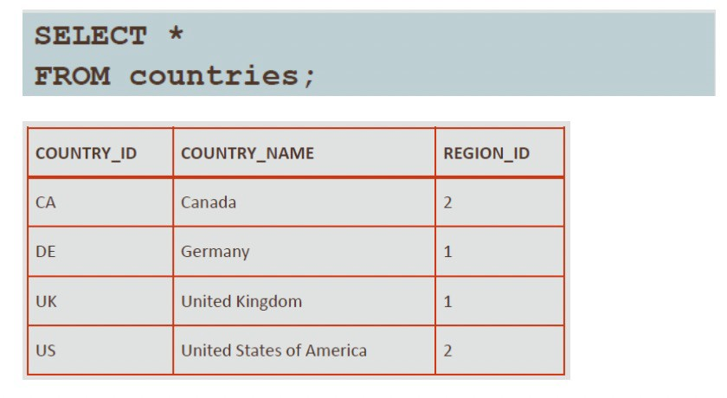
Retrieving all data using SELECT statement
Official (Open)
SELECT * FROM <tablename> Displays all columns of all rows of data
Notes:
* : everything from the table

Slide 18
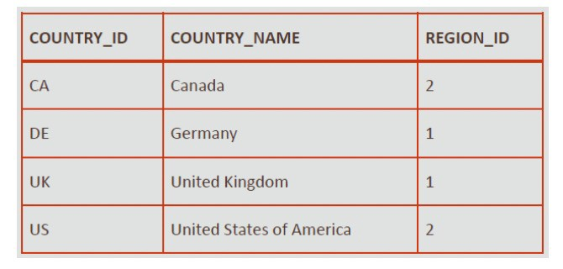
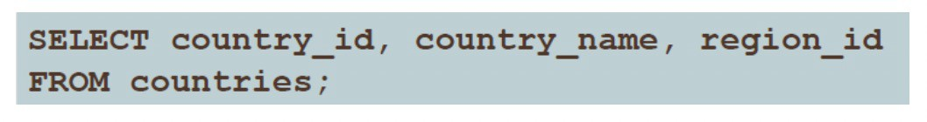
Retrieving selected data using SELECT statement
Official (Open)
SELECT <columnname> FROM <tablename> Displays a specific column of all rows of data
SELECT <columnname1> , <columnname2> FROM <tablename> Displays two specific columns of all rows of data.

Slide 19
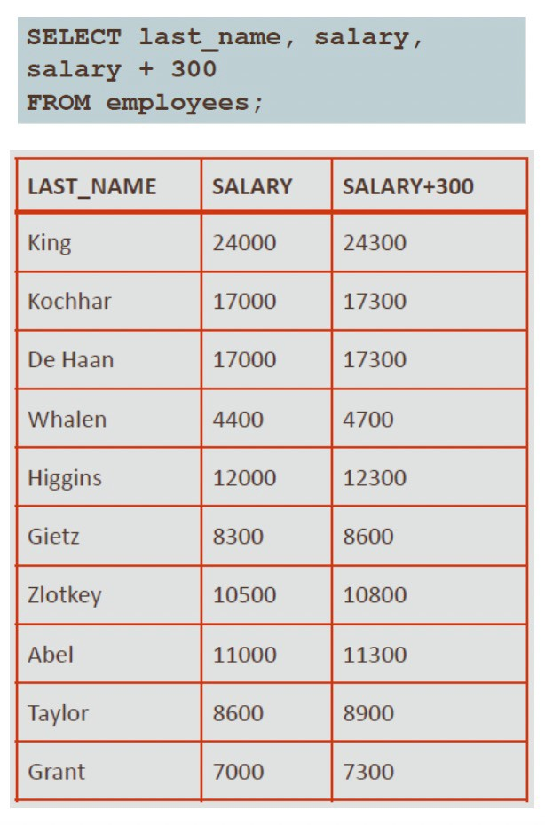
Using arithmetic operators
Official (Open)
add (+), subtract (-), multiply (*) and divide (/). Precedence order: * / + -
If operators within an expression are of the same priority, then evaluation is done from left to right. You can always use parentheses to force the expression within parentheses to be evaluated first.
Notes:
Automatically create a column that involves arithmetic operators
The example table initially only have 2 columns

Slide 20
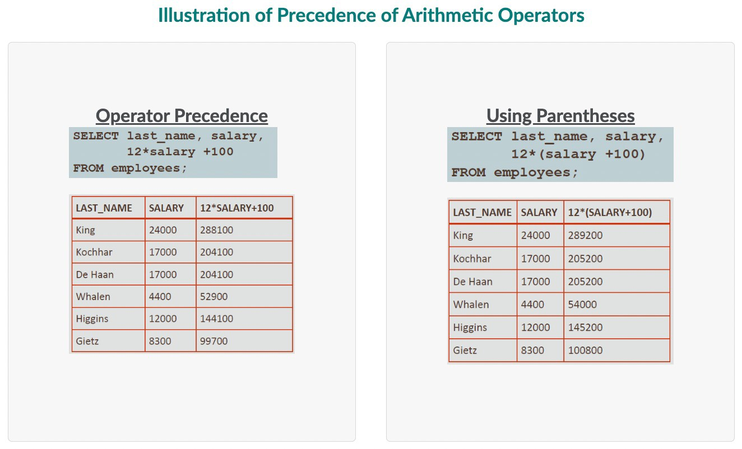
Official (Open)

Slide 21
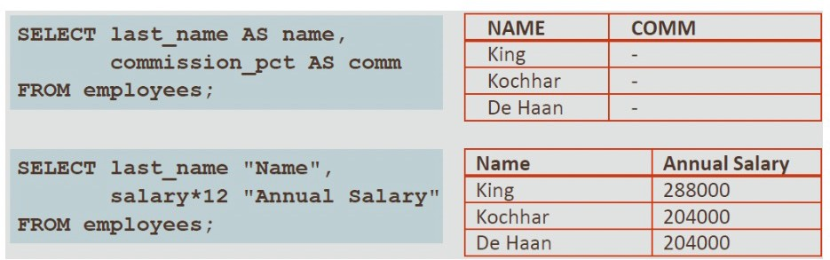
Alias
Official (Open)
An Alias is a way of renaming a column heading in the output. Syntax:
SELECT * |column|expr [ AS alias], ..... FROM table;
Notes:
Use string when it is not capitalized

